Slide 1
MAE 3193 DP2 - Eazy Drop
By: Liam Colvin, Benjamin Elwell, Omar Hassan, Nick Karlsson

Slide 2
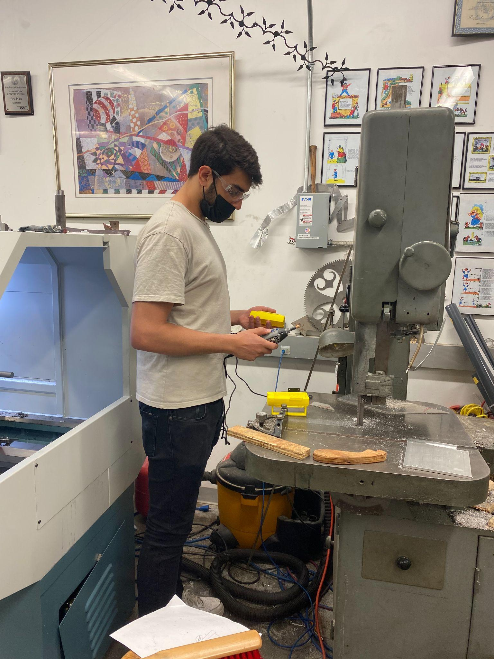
Presentation Overview
Problem Definition
Background
CRs and ECs
Conceptual Design
Detail Design
Prototype + Performance Evaluation
Customer Feedback
Revisions/Future Work

Slide 3
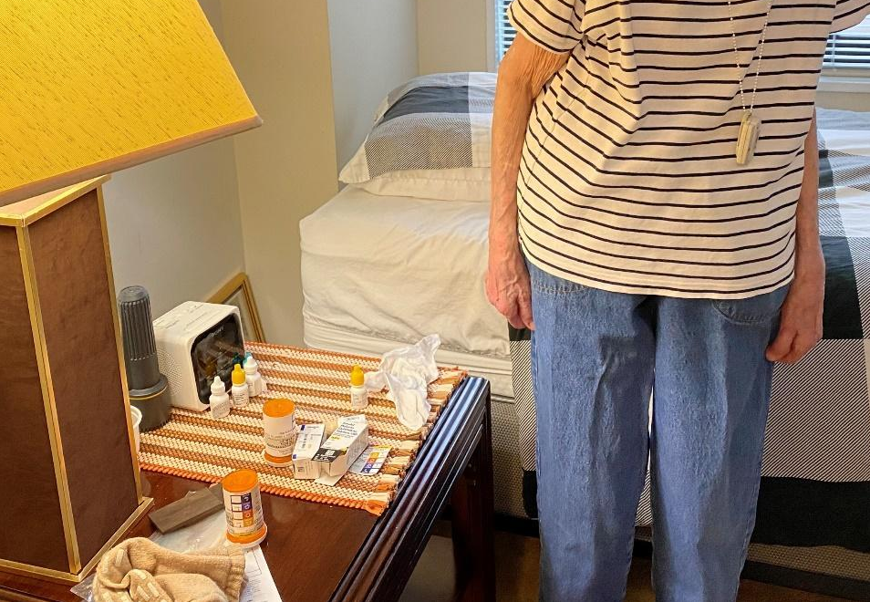
Problem Definition
Ms. Bernstein’s difficulties
Break the seal
Align eye drops (lack of vision)
Limited hand strength
Designed for elderly and visually impared
Notes:
Dr lodhi

Slide 4
Background Information
Background research and Customer Interview:
Visual impairment is common: 12 million impaired and 1 million blind (CDC)
Dr. Lodhi and Ms. Bernstein
Missed eye drops
Opens cap with pliers
May forget if eye drops were taken
Tells which bottle is which with texture

Slide 5
Customer Requirements and Engineering Constraints
CR | Importance | EC | Units | D-o-I | Target
Quick to Use | 5 | Time to administer medication | Seconds | Down | 5 Seconds
Easy to Use | 5 | Force required to squeeze | lbs | Down | 3 lbf
Dropper Alignment | 5 | Drop placement Accuracy | % | Up | 35% Improvement
Administers Correct Amount | 5 | Drop Number Accuracy Rate | % | Up | 35% Improvement
Breaks Dropper Seal | 3 | Torque Required | in-lbf | Down | 5 in-lbf
Notes:
EC -> importance -> Units -> Target Value
Quick to use - convenient and easy
Low force required - eldery experience macular degeneration, making fine motor skills difficult
Dropper alignment - does the drop reach her eyes
Drop number accuracy - if she needs one drop she gets one drop, not a jet of medication
Breaks dropper seal - need to have

Slide 6
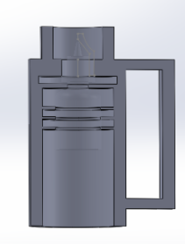
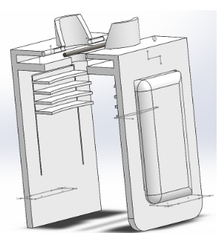
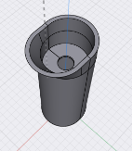
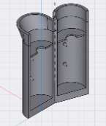
Conceptual Design
Design 1
Design 3
Notes:
Ideation: creative and systematic
Creative:
Systematic
Rough to refined
Predict Performance
Design selection

Slide 7
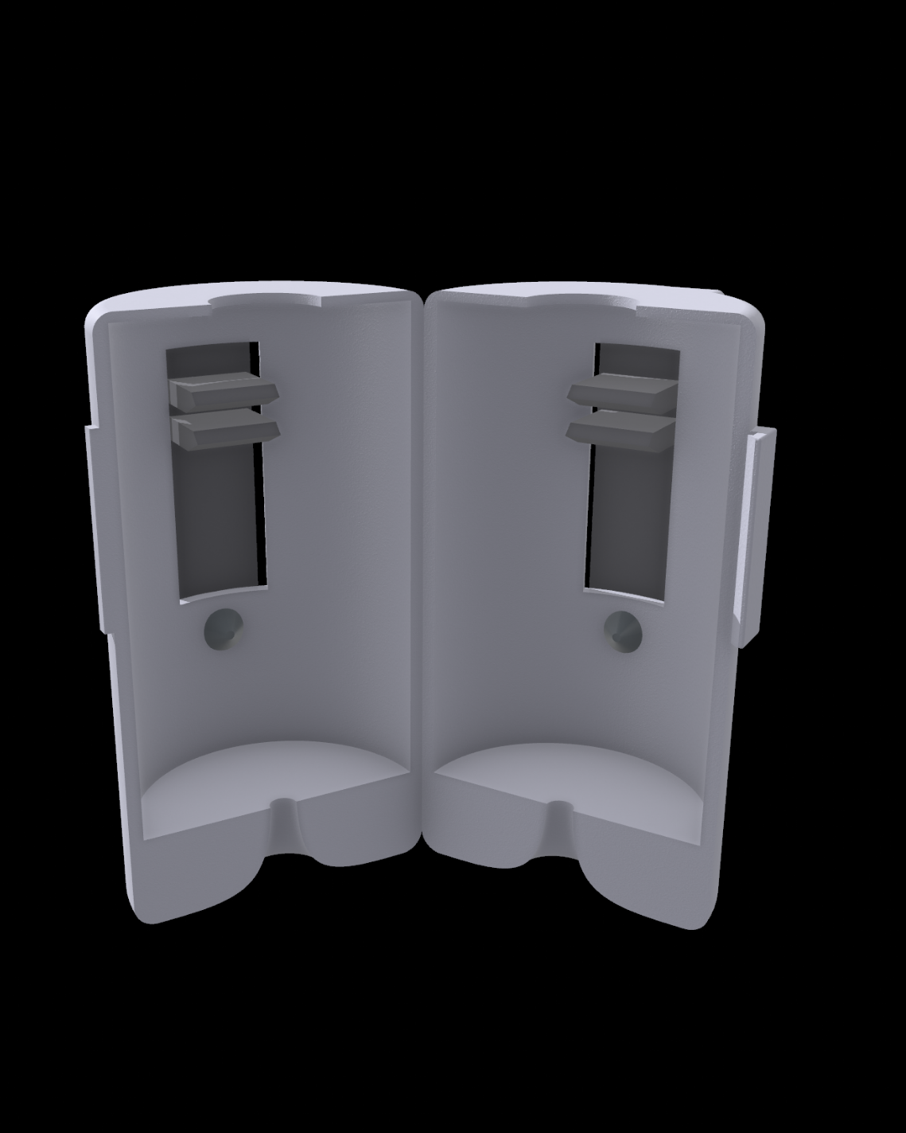
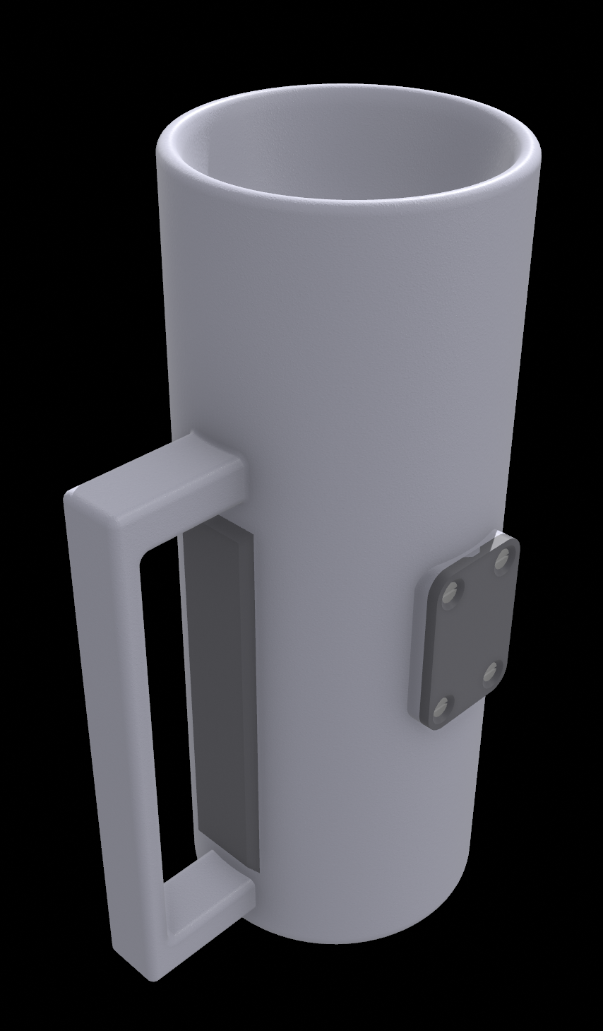
Detail Design
Primary Features
Fins on tabs
Cylindrical shape
Safety Handle
Eye cup
Hinge and clasp
Seal breaker
Notes:
Using configuration design methods, Characteristics of design 1 and 3 were combined to produce the first detail design prototype.
The fins from design 1 replaced the conical pressure points of design 3 through the use of a flexible plate. Fins offer greater mechanical advantage than cones from design 3.
The body of design 3 was improved upon and modified to accommodate the fins. Most prototypes were cylindrical, a much more ergonomic design than the rectangular dimensions of design 1.

Slide 8
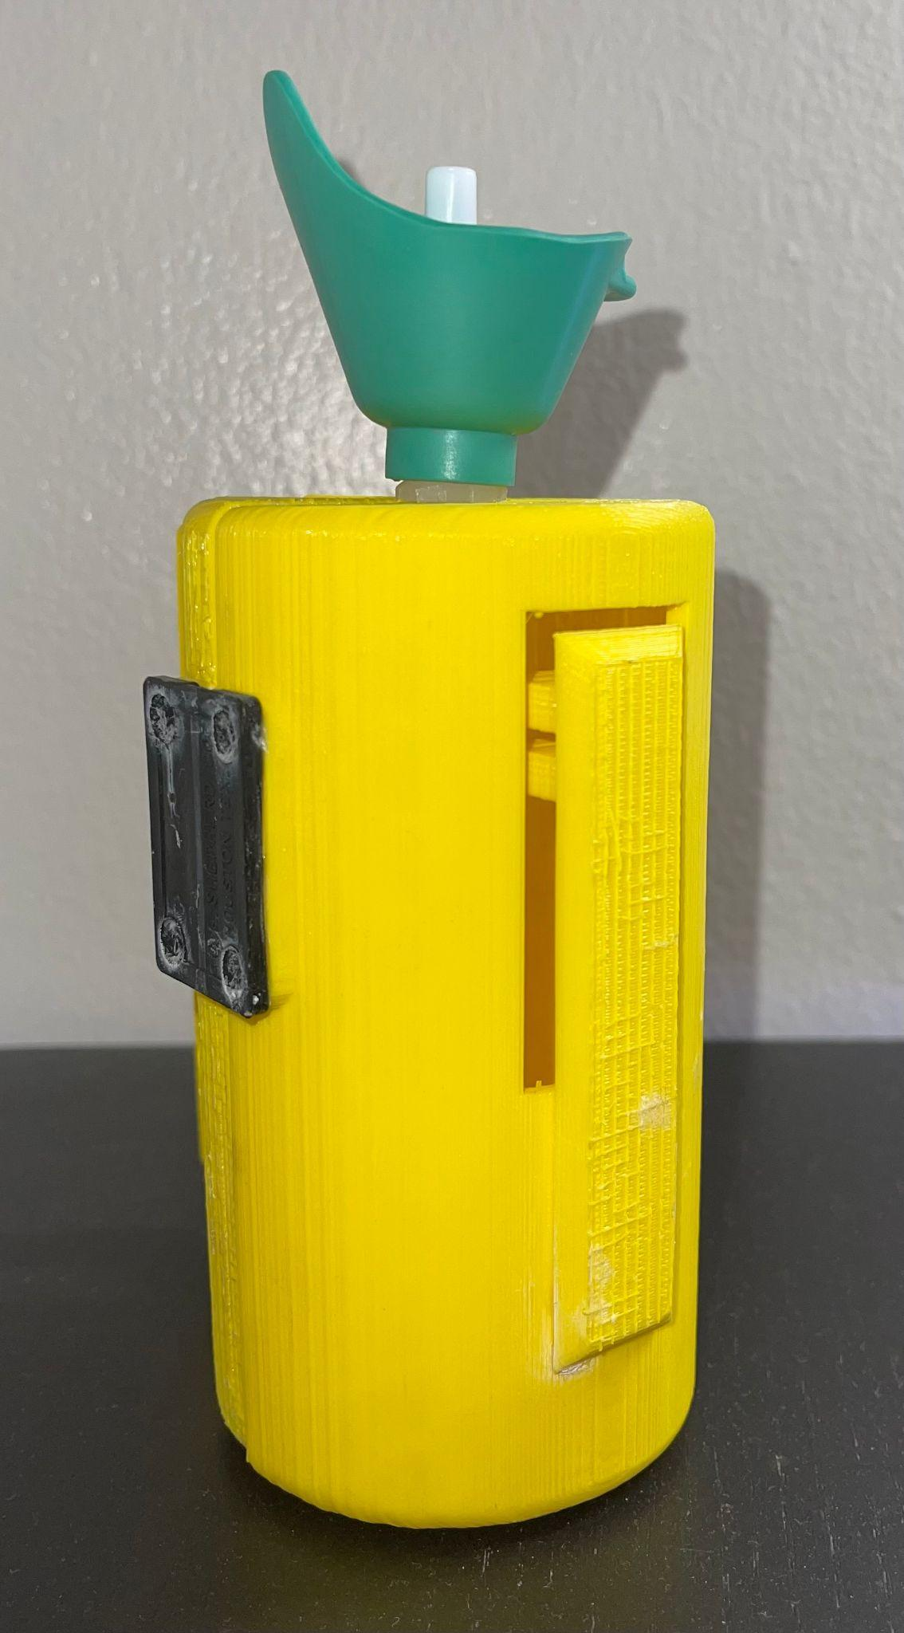
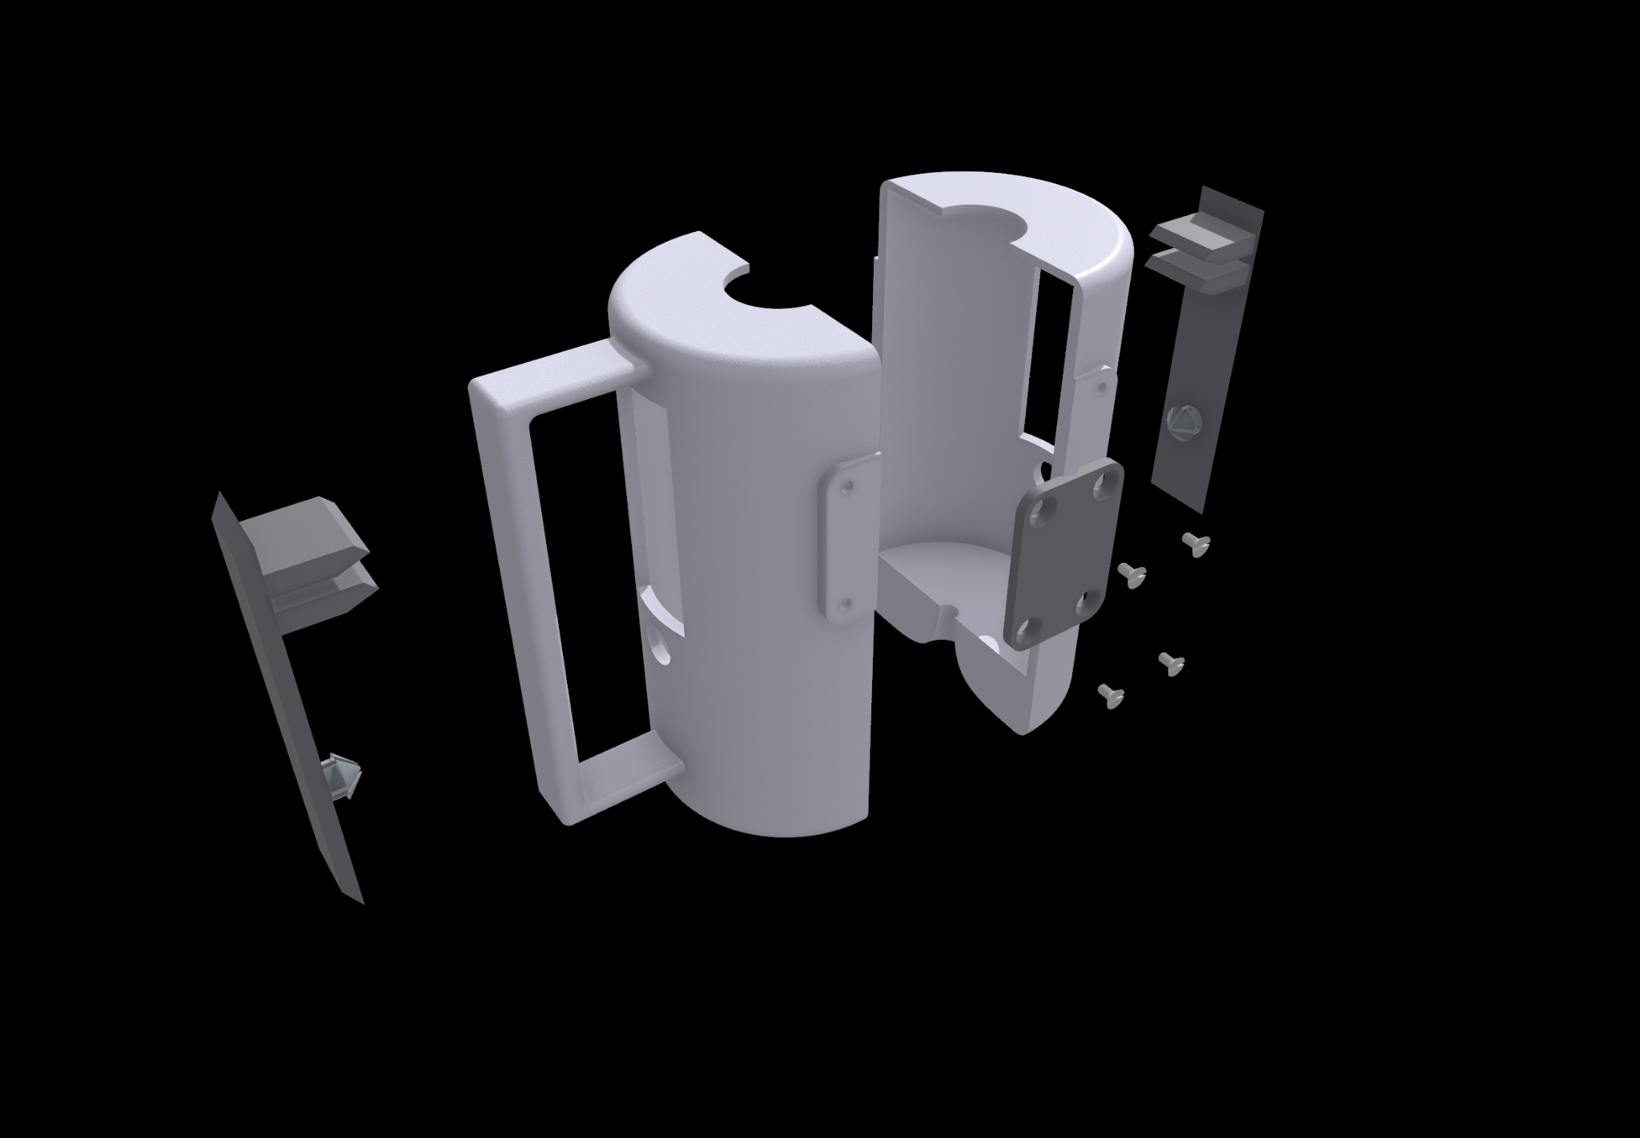
Final Design
Redesigned features:
Overall length reduction
Introduced standard eyepiece
Increased tab size
Decrease screw and bottle securing hole sizes
Notes:
Using parametric design methods
Where did our original design fall short?
What specifically did we change?
The detail design prototype fell short in several ways that had to be improved upon in the final design.
Original eye-piece was ineffective, was replaced by eye-piece from Amazon
There was no clasp mechanism in original design, was added to final model
Large cut-outs were added for the pressure plate since the casing would not be able to flex

Slide 9
Performance Evaluation
EC | Units | D-o-I | Target Value | Measured Value
Time to administer medication | Seconds | Down | 5 Seconds | 7 Seconds | 🚫
Force required to squeeze | lbf | Down | 3 lbf | ~3 lbf | ✅
Drop placement Accuracy | % | Up | 35% Improvement | 40% Improvement | ✅
Drop Number Accuracy Rate | % | Up | 35% Improvement | 0% | 🚫
Torque Required | in-lbf | Down | 5 in-lbf | 6 in-lbf | 🚫

Slide 10
Customer Feedback
After showcasing our product to Ms. Bernstein…
Pros | Cons
Enjoyed the Rubber Eyepiece | Too Large
Easy to Squeeze (Enables the use of your whole hand) | Difficult to Open

Slide 11
What would be changed
Make the product smaller
Have the eye piece attached to the product
Material Selection
Better finish
Better tab connection
Hinge and clasp redesign

Slide 12
Questions?

